Slide 1
CBI UV-light induced dermal inflammation in hairless mice
A TRANSLATIONAL APPROACH TO PRECLINICAL RESEARCH
Comparative Biosciences, Inc.
786 Lucerne Drive
Sunnyvale, CA 94085
Telephone: 408.738.9261
www.compbio.com

Slide 2
Comparative Biosciences, Inc.
A TRANSLATIONAL APPROACH TO PRECLINICAL RESEARCH
Premier Preclinical Contract Research Organization
Specializing in Dermal and Ocular Pharmacology, Toxicology and Histopathology
18 Years in business
Located in the heart of Silicon Valley
State of the art, purpose-built facility
~30 employees with 7 PhDs, 2 pathologists
Experienced study directors and scientists
AAALAC Accredited, GLP, OECD, FDA, USDA, OLAW

Slide 3
UV-Light Induced dermal inflammation in hairless mice
A TRANSLATIONAL APPROACH TO PRECLINICAL RESEARCH
UVB irradiation for 4 days
Treatment for up to 1 week
Draize scoring and photography 3 or more times a week
Body weights 3 or more times a week
Histopathology
Immunohistochemistry
Cytokine panel
Complete report

Slide 4
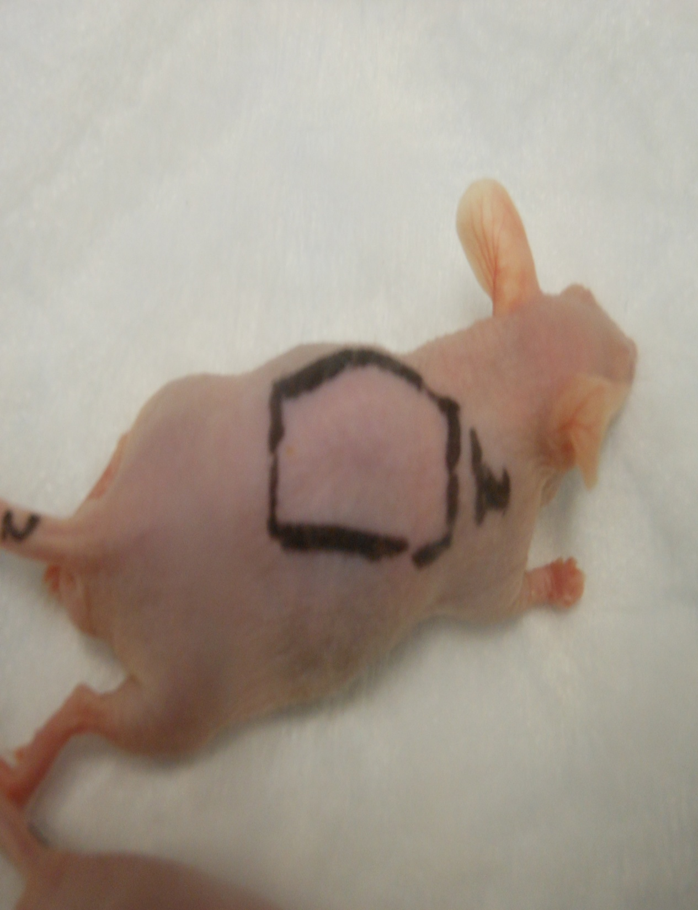
Normal Hairless Mouse
A TRANSLATIONAL APPROACH TO PRECLINICAL RESEARCH
A normal hairless mouse is prepped for treatment

Slide 5
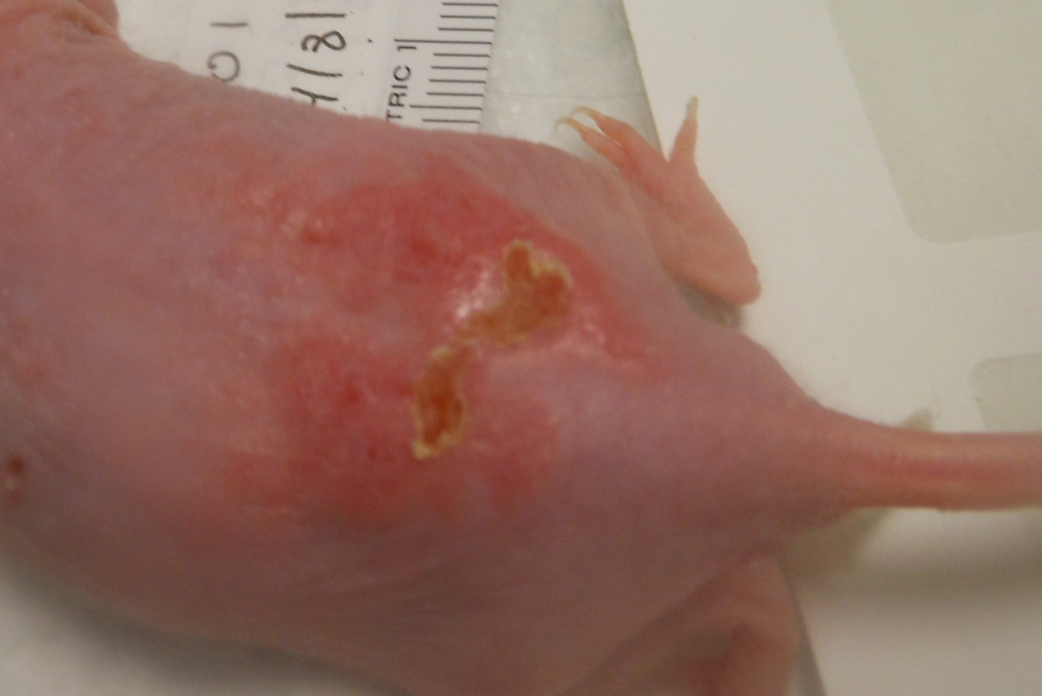
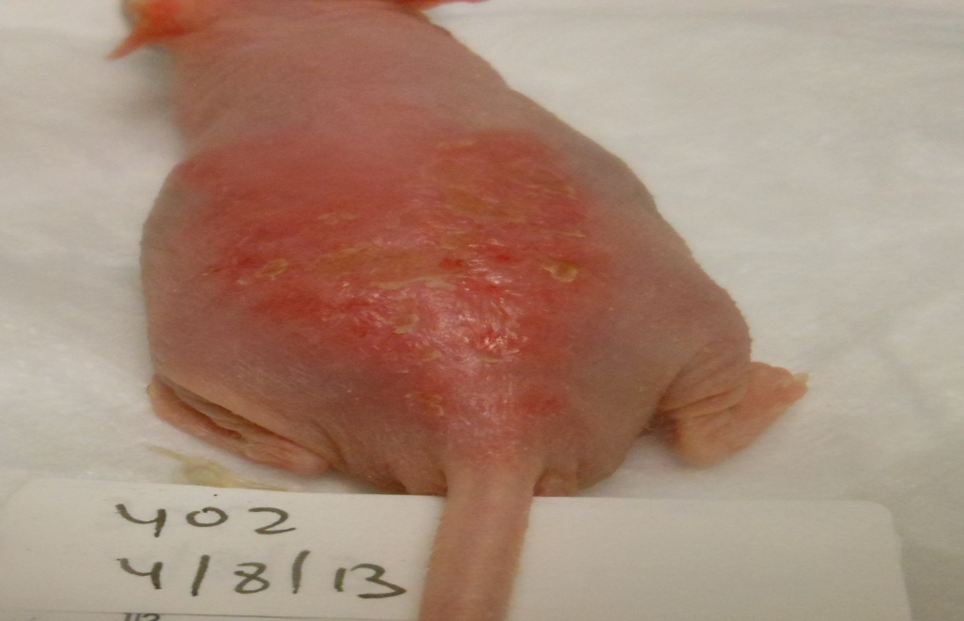
Hairless mouse following 4 days of UVB light irradiation
A TRANSLATIONAL APPROACH TO PRECLINICAL RESEARCH
Exposure site on backs of mice are red and edematous.

Slide 6
Hairless mouse following 4 days of UVB light irradiation-Day 8 The skin is healing and redness is reduced
A TRANSLATIONAL APPROACH TO PRECLINICAL RESEARCH

Slide 7
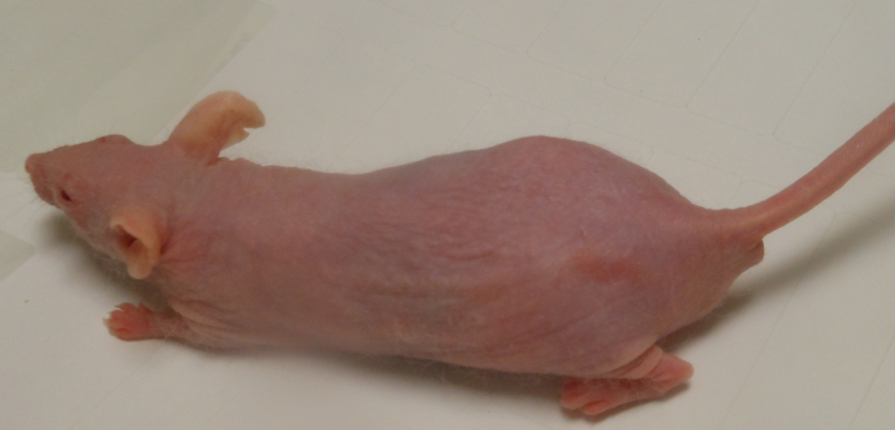
Hairless mouse following 4 days of UVB light irradiation-Day 14-Healed
A TRANSLATIONAL APPROACH TO PRECLINICAL RESEARCH
After 2 weeks, the lesion is well resolved.

Slide 8
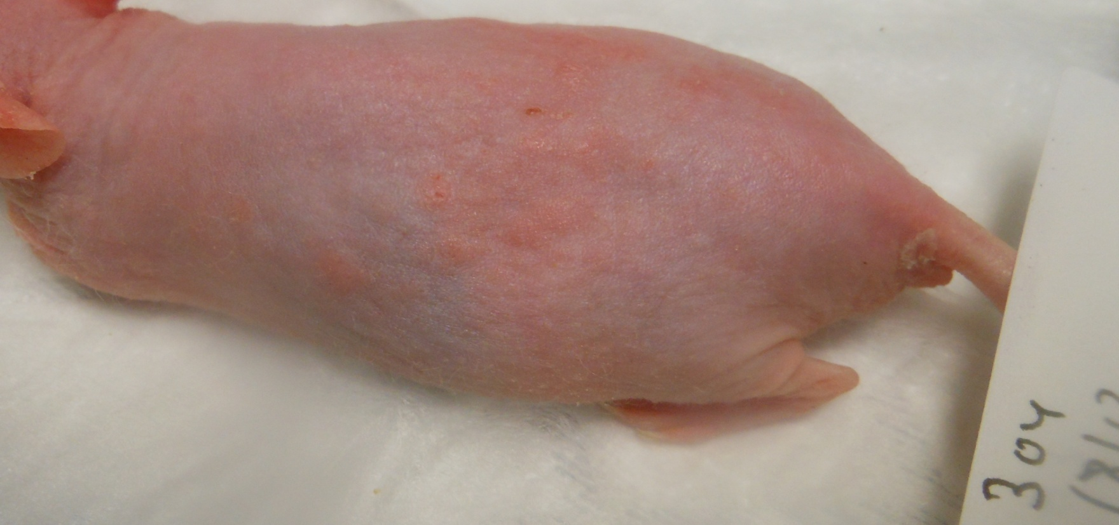
Hairless treated mouse following 4 days of UVB light irradiation and treatment with anti-inflammatory -Day 10
A TRANSLATIONAL APPROACH TO PRECLINICAL RESEARCH
The dermal lesion is healed.

Slide 9
Characteristic Histopathology
A TRANSLATIONAL APPROACH TO PRECLINICAL RESEARCH
Marked epidermal thickening (acanthosis) and associated increases in surface keratin (hyperkeratosis).
Increased basal layer mitosis of the basal layer, and spongiform edema of the keratinocytes in the prickle cell layer.
Epidermis 8-15 cells thick (1-2 cell layer thickness normal murine skin.
Mild to moderate to severe, multifocal inflammation was, composed of foci of an admixture of neutrophils with fewer monocytes, lymphocytes, eosinophils, thrombi and macrophages in dermal stroma and surrounding follicles.
Hair follicles dilated, increased layers of keratin leading to dilation, obstruction, and inflammation of the follicle and duct with layers of keratin.

Slide 10
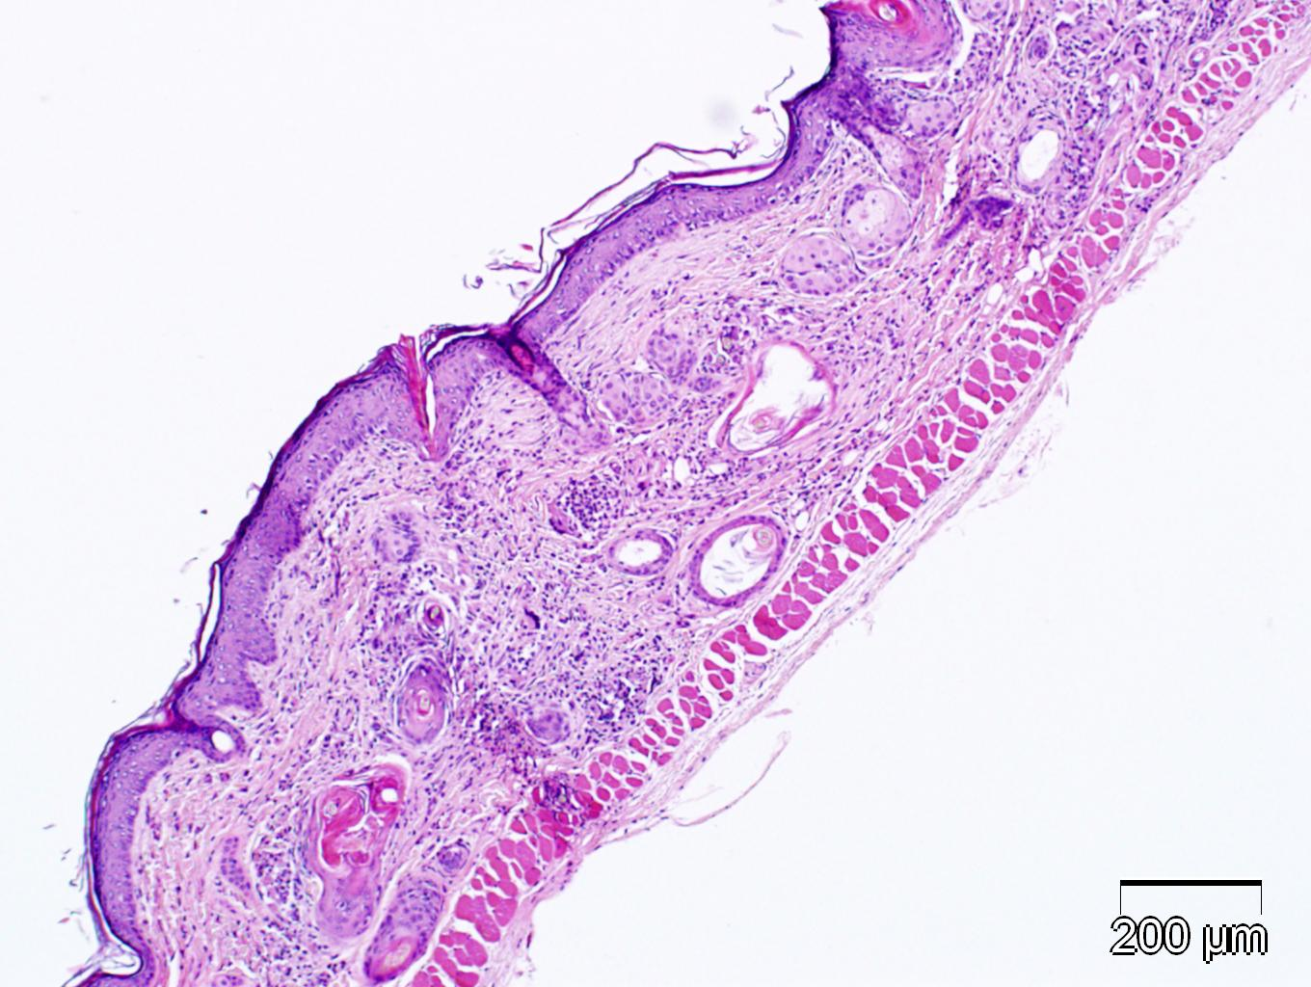
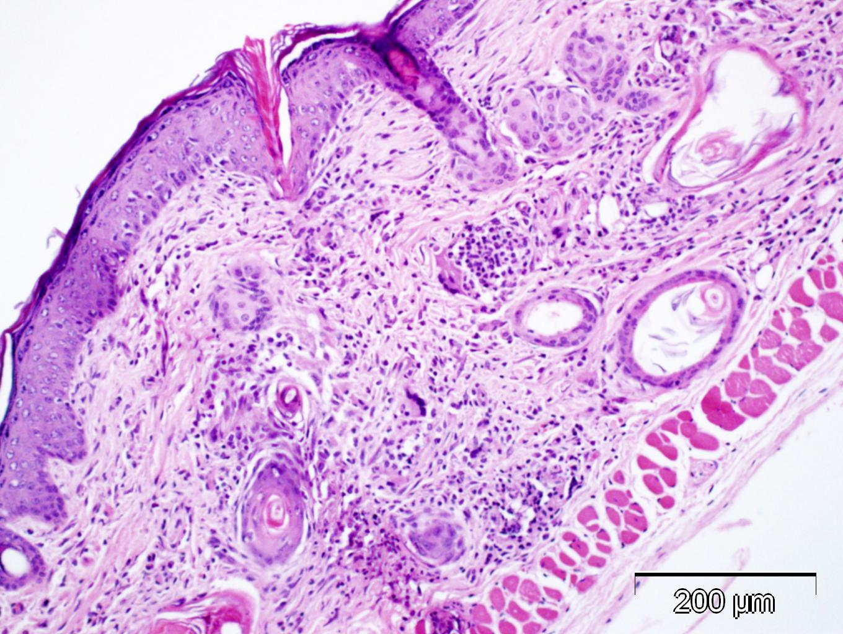
Histopathology
A TRANSLATIONAL APPROACH TO PRECLINICAL RESEARCH
There is epidermal acanthosis and hyperkeratosis with moderate to several dermal inflammation and dilation of hair follicles with keratinic debris. Day 6

